Slide 1

CS 584 Machine Learning
Week 6
February 20, 2019

Slide 2

Week 6 Agenda: Decision Trees
Classification and Regression Tree (CART) algorithm
Apply the decision tree algorithm for clustering
Use the decision tree algorithm to generate the clusters’ profiles
Chapter 9 of the Machine Learning book

Slide 3
Getting Started: Predict Mortgage Default
The hmeq.csv holds information about 5,960 mortgage applications.
The field BAD indicates if the applicant paid the mortgage or not.
A loan officer wants a rule-based decision scheme to predict the likelihood of default.
A rule-based decision is like this: If an application has certain particular characteristics, then the likelihood of default is p%.
In other words, the loan officer wants to construct a sketch of an applicant who has a high likelihood to default a loan.
Week 5 HMEQ CART.py

Slide 4
Variables in the Home Equity Dataset
Variable | Role | Level | Description
BAD | Target | Binary | Status of loan: 1 = applicant defaulted on the loan or is seriously delinquent 0 = applicant paid the loan on schedule
CLAGE | Input | Interval | Age of oldest credit line (months)
CLNO | Input | Interval | Number of credit lines
DEBTINC | Input | Interval | Debt-to-income ratio
DELINQ | Input | Nominal | Number of delinquent credit lines
DEROG | Input | Nominal | Number of major derogatory reports
JOB | Input | Nominal | Occupation category (Mgr, Office, Other, ProfExe, Sales, Self)
LOAN | Input | Interval | Requested loan amount (dollars)
MORTDUE | Input | Interval | Amount due on existing mortgage (dollars)
NINQ | Input | Nominal | Number of recent credit inquiries
REASON | Input | Binary | Reason for loan: DebtCon = debt consolidation; HomeImp = home improvement
VALUE | Input | Interval | Value of current property (dollars)
YOJ | Input | Interval | Number of years at present job

Slide 5
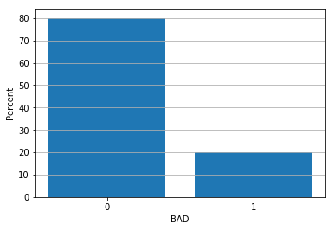
Overall Default Rate
BAD Count Percent
0 4771 80.050336
1 1189 19.949664
All 5960 100.000000
5,960 applicants
19.95% or 1,189 applicants defaulted on the loan or is seriously delinquent
If the 5,950 applicants are assumed from the same homogeneous population, then the loan officer will randomly decline 19.95% of all applications regardless of the information on the applications.

Slide 6
Does the Loan Default Rate Vary?
Interval Variables
CLAGE, CLNO, DEBTINC, LOAN, MORTDUE, VALUE
Scatterplot – the vertical axis represents the default rates
Numeric Ordinal Variable
DELINQ, DEROG, and NINQ
Bar chart – the bars represent the default rates

Slide 7
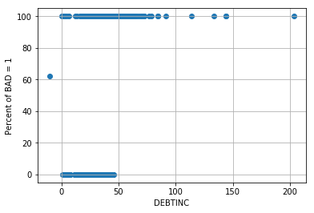
Does the Loan Default Rate Vary?
When DEBTINC is missing, the default rate is about 60%.
When DEBTINC > 50, the default rates are 100%.
If we divide the data using DEBTINC > 50, then we may get two segments.
Week 6 HMEQ CART.py

Slide 8
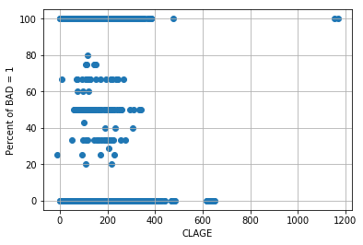
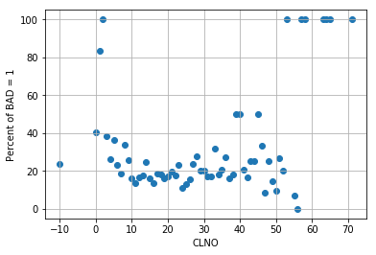
Does the Loan Default Rate Vary?
No Visible Segments
No Visible Segments but a downward trend is plausible

Slide 9
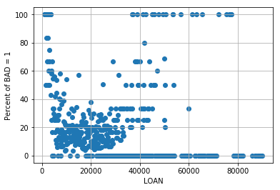
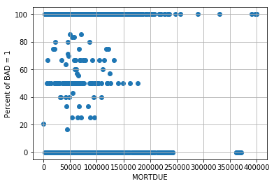
Does the Loan Default Rate Vary?
No Visible Segments but a curve is plausible
No Visible Segments

Slide 10
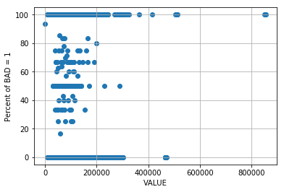
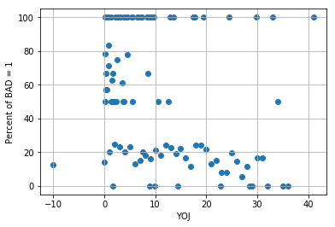
Does the Loan Default Rate Vary?
No Visible Segments
No Visible Segments

Slide 11
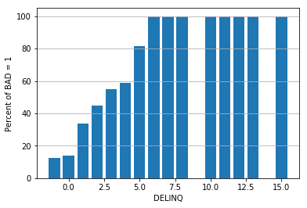
Does the Loan Default Rate Vary?
When DELINQ is missing or equals to 0, the default rates are much lower than the rest.
When DELINQ > 0, the default rates increase as DELINQ increases.
When DELINQ > 4, the default rate jumps again

Slide 12
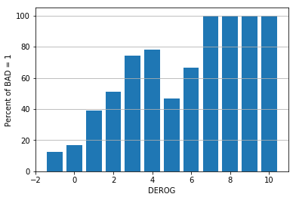
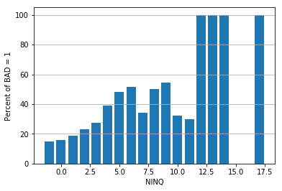
Does the Loan Default Rate Vary?
No Visible Segments
No Visible Segments

Slide 13
Decision Tree Model
A rule-based decision model
Observations are assigned to mutually exclusive segments
Segments are defined and constructed by rules
Rules are expressed as a series of Boolean decisions connected by the AND operators, e.g., (DEBTINC <= 50) and (DELINQ > 1.5)
Decisions are defined by values or ranges of values of predictors
Rules are established with the goal to create segments of observations which can differentiate among themselves the most statistically.
Also known as Recursive (Data) Partitioning in other fields (e.g., medical or public health)

Slide 14
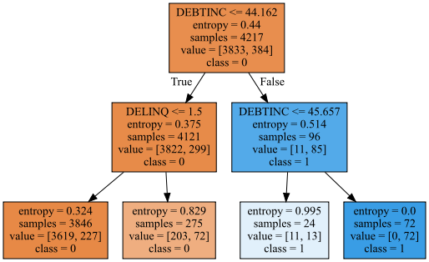
Decision Tree Diagram
Read from Top, and Go Down!

Slide 15
Terminology
Each box in the tree diagram is called a Node.
Each line in the tree diagram is called a Branch or a Split.
A tree diagram is displayed in layers, the number of layers minus one is the Depth (e.g., this tree has 3 layers but only 2 levels deep)
The predictor used to create a branch is called the Branching Variable or the Splitting Variable
DEBTINC is the splitting variable in the first level
DELINQ is a splitting variable in the second level and DEBTINC is used again as another splitting variable

Slide 16
Terminology
A Parent Node is a node where the branch comes from.
A Child Node is a node where the branch goes into.
The Root Node is the node where there are no branches which go into it.
There is only one Root Node is a Tree Diagram.
The Root Node is at Level 0
A Terminal Node is a node where there no branches that come from it.

Slide 17
Tree Diagram
Read from Top, and Go Down!

Slide 18
Describe Terminal Nodes
Identify the terminal nodes
Trace the decision path that runs from the Root Node to the terminal node
Describe the terminal node by the decision path and simplify the decision path by resolving any redundancy

Slide 19
Four Terminal Nodes
DEBTINC <= 44.162 and DELINQ <= 1.5
DEBTINC <= 44.162 and DELINQ > 1.5
DEBTINC > 44.162 and DEBTINC <= 45.657
An equivalent rule is 44.162 < DEBTINC <= 45.657
DEBTINC > 44.162 and DEBTINC > 45.657
When DEBTINC > 45.657, the condition DEBTINC > 44.162 is redundant
Thus, the simplified rule is DEBTINC > 45.657

Slide 20
Four Decision Rules
Decision Rule | N Observations | % Obs. BAD = 1 | Predicted Class | Entropy
DEBTINC <= 44.162 and DELINQ <= 1.5 | 3,846 | 227 / 3846 = 5.90% | BAD = 0 | 0.324
DEBTINC <= 44.162 and DELINQ > 1.5 | 275 | 72 / 275 = 26.18% | BAD = 0 | 0.829
44.162 < DEBTINC <= 45.657 | 24 | 13 / 24 = 54.17% | BAD = 1 | 0.995
DEBTINC > 45.657 | 72 | 72 / 72 = 100% | BAD = 1 | 0

Slide 21
Splitting Criteria
The goal of building a Decision Tree is to subdivide the data by predictors in such a way that the response values for the observations in the terminal nodes are as similar as possible.
There are two common types of criteria:
Maximize a decrease in node impurity, as defined by an impurity function
Minimize a p-value defined by a statistical test

Slide 22
Splitting Criteria
 | Nominal Target | Interval Target
Criteria Based on Impurity | Entropy Gini Index | Residual Sum of Squares
Criteria Based on Statistical Test | Chi-Squares | F-Test

Slide 23
Popular Algorithms
CART – Classification And Regression Trees
Leo Breiman, Jerome Friedman, Charles J. Stone, Richard A. Olshen (1984). Classification and Regression Trees, Belmont, California: Wadsworth International Group.
CHAID – CHi-squared Automatic Interaction Detector
Gordon V. Kass (1980). An Explanatory Technique for Investigating Large Quantities of Categorical Data, Applied Statistics (Journal of the Royal Statistical Society, Series C), volume 29, number 2, pages 119-127.

Slide 24
CART Algorithm: History
The CART algorithm was first introduced in the 1984 book by Leo Breiman, Jerome Friedman, Charles J. Stone, and Richard A. Olshen
Leo Breiman (1928 – 2005), Professor Emeritus of Statistics at University of California, Berkeley
Jerome Friedman (1939 – ), Professor of Statistics at Stanford University, https://statweb.stanford.edu/~jhf/
Charles Stone, Professor Emeritus of Statistics at University of California, Berkeley, http://vcresearch.berkeley.edu/faculty/charles-stone
Richard A. Olshen (1942 – ), Professor of Health Research and Policy, Stanford University, http://statweb.stanford.edu/~olshen/
The first commercial software is CART® of the Salford Systems
Charles Stone on Data Mining Tool CART ( https://www.youtube.com/watch?v=aDy6mzbS8rs )

Slide 25
CART Algorithm: Overview
Classification Tree is for categorical target variables.
Regression Tree is for interval target variables.
CART is supposed to deal with the missing values in predictors.
CART should not be affected by outliers and collinearities.
Outliers are put aside into a separate node and are not used in splitting.
CART is invariant under monotone transformation of predictors.
For example, taking the logarithm, the square, or the square root of predictors has no effect on the overall shape of the tree produced.

Slide 26
CART Algorithm: Overview
Let us consider the observations in a parent node
The parent node may be impure, in other words, the observations in the parent node come from heterogeneous populations
The goal is to create a rule that breaks up these observations into groups where observations are less impure (i.e., more homogenous).
A common rule is to break observations into two (2) groups.
Each group is a child node.
In the next layer, the child nodes become the parent nodes, and here we go again.

Slide 27
CART Algorithm: Technical Details
Start with the first predictor, select a value to split data in the node into two partitions.
Interval or Ordinal Predictors: {x: x < a} and {x: x ≥ a} where a is a value
Nominal Predictor: {x: x  A} and {x: x  A} where A is a subset of values
Apply the Goodness of Split Criterion, calculate the impurity of the partitions, and evaluate the reduction of impurity from the parent node.
Select the split partition that results in the largest reduction of impurity and labels it the “best” split for the predictor.

Slide 28
CART Algorithm: Technical Details
Repeat steps 1 to 3 for each remaining predictors. Go to step 5 when “best” splits are found for all predictors.
Ranks all of the “best” split of each predictor according to the reduction in impurity achieved by each split.
Select the predictor and its split partition that most reduced impurity of the parent node.
Assign observations to one of the two child nodes.
Determine whether the child nodes are terminal based on the Stopping Criteria
Repeat steps 1 to 8 for each non-terminal child nodes.

Slide 29
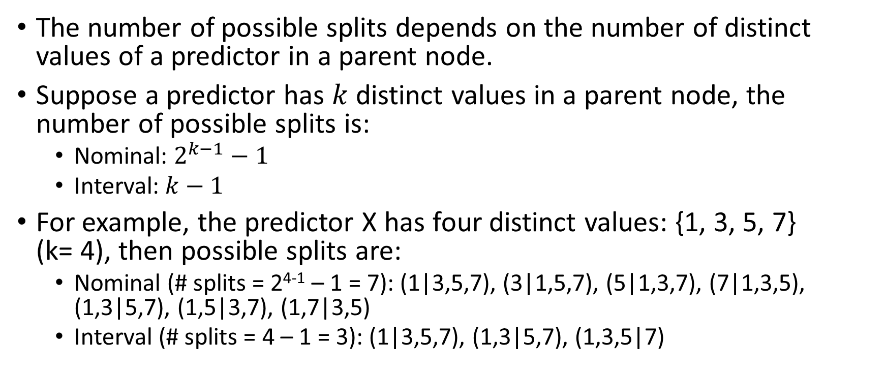
CART Algorithm: Number of Possible Splits
The number of possible splits depends on the number of distinct values of a predictor in a parent node.
Suppose a predictor has $k$ distinct values in a parent node, the number of possible splits is:
Nominal: $2^{k−1}−1$
Interval: $k−1$
For example, the predictor X has four distinct values: {1, 3, 5, 7} (k= 4), then possible splits are:
Nominal (# splits = 2⁴⁻¹ – 1 = 7): (1|3,5,7), (3|1,5,7), (5|1,3,7), (7|1,3,5), (1,3|5,7), (1,5|3,7), (1,7|3,5)
Interval (# splits = 4 – 1 = 3): (1|3,5,7), (1,3|5,7), (1,3,5|7)

Slide 30
CART Algorithm: Pre-Bin Interval Predictors
In order to maintain good performance, interval predictors may be pre-binned into a large pre-determined number (e.g., 100) of equal-width bins.
These bins will then be used as ordinal predictors instead of the original interval predictors.

Slide 31
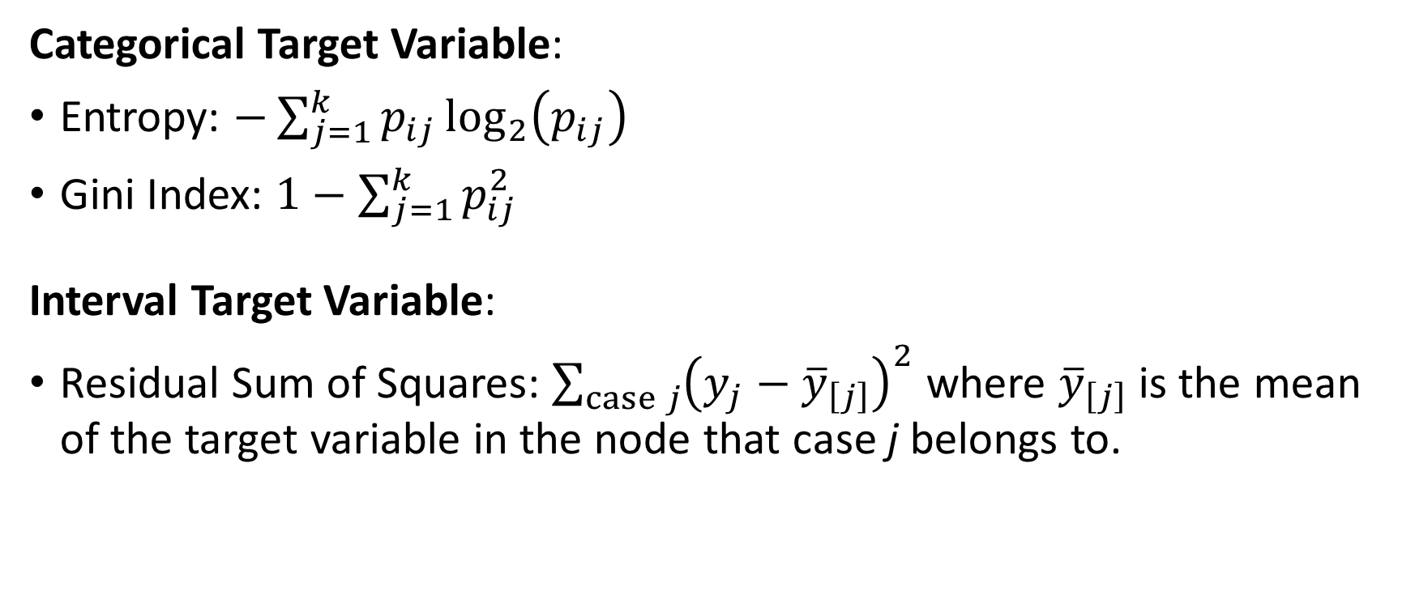
CART Algorithm: Impurity Metric
Categorical Target Variable:
Entropy: $−\sum_{j=1}^{k}{p_{ij}\log_{2}\left(p_{ij}\right)}$
Gini Index: $1−\sum_{j=1}^{k}{p_{ij}^{2}}$
Interval Target Variable:
Residual Sum of Squares: $\sum_{case j}{{\left(y_{j}−{\overline{y}}_{\left[j\right]}\right)}^{2}}$ where ${\overline{y}}_{\left[j\right]}$ is the mean of the target variable in the node that case j belongs to.

Slide 32
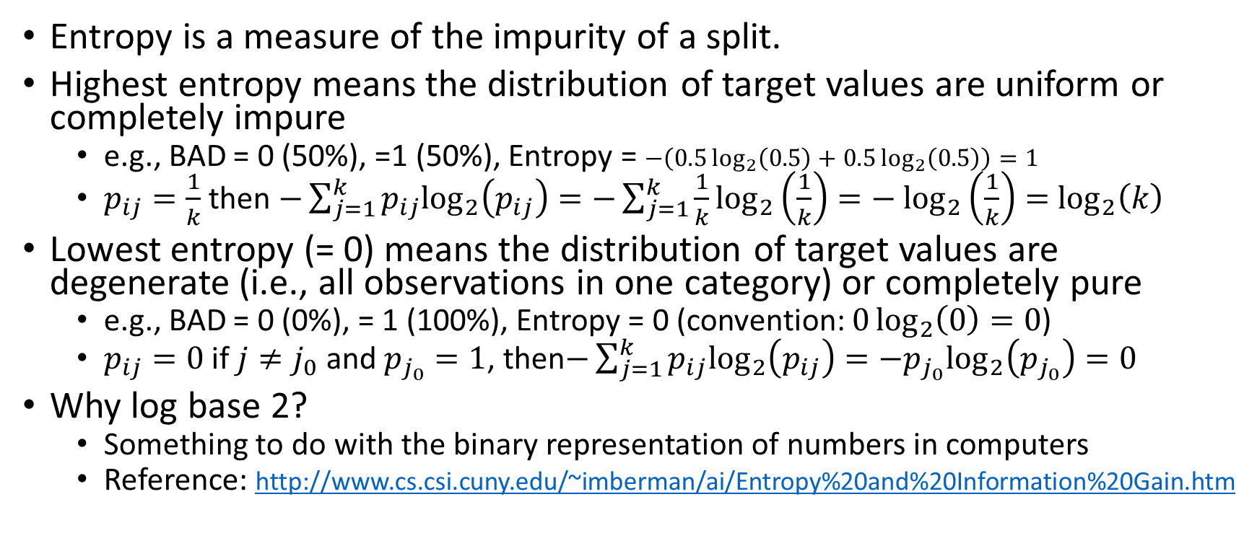
CART Algorithm: Entropy
Entropy is a measure of the impurity of a split.
Highest entropy means the distribution of target values are uniform or completely impure
e.g., BAD = 0 (50%), =1 (50%), Entropy = $−\left(0.5\log_{2}\left(0.5\right)+0.5\log_{2}\left(0.5\right)\right)=1$
$p_{ij}=\frac{1}{k}$ then $−\sum_{j=1}^{k}{p_{ij}\log_{2}\left(p_{ij}\right)}=−\sum_{j=1}^{k}{\frac{1}{k}\log_{2}\left(\frac{1}{k}\right)}=−$ $\log_{2}\left(\frac{1}{k}\right)=$ $\log_{2}\left(k\right)$
Lowest entropy (= 0) means the distribution of target values are degenerate (i.e., all observations in one category) or completely pure
e.g., BAD = 0 (0%), = 1 (100%), Entropy = 0 (convention: $0\log_{2}\left(0\right)=0$)
$p_{ij}=0$ if $j≠j_{0}$ and $p_{j_{0}}=1$, then$−\sum_{j=1}^{k}{p_{ij}\log_{2}\left(p_{ij}\right)}=−p_{j_{0}}\log_{2}\left(p_{j_{0}}\right)=0$
Why log base 2?
Something to do with the binary representation of numbers in computers
Reference: http://www.cs.csi.cuny.edu/~imberman/ai/Entropy%20and%20Information%20Gain.htm

Slide 33
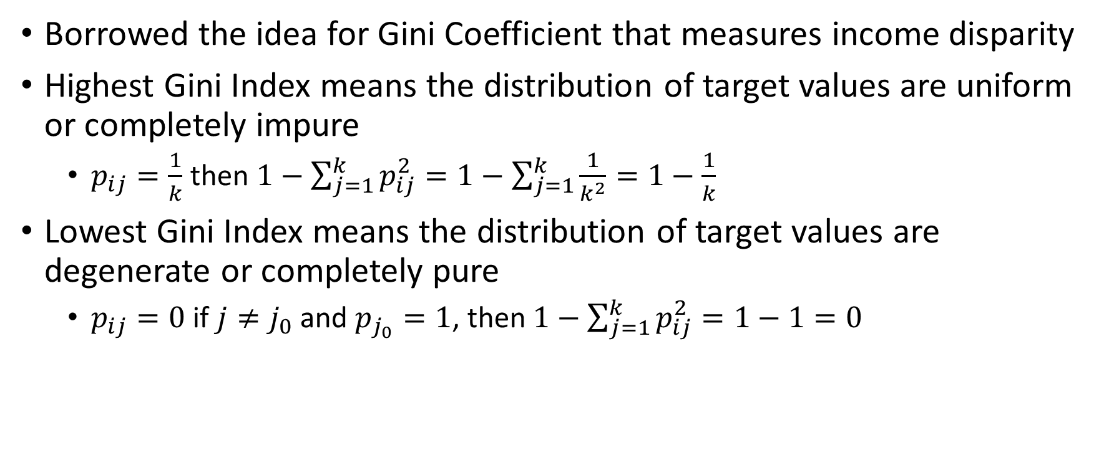
CART Algorithm: Gini Index
Borrowed the idea for Gini Coefficient that measures income disparity
Highest Gini Index means the distribution of target values are uniform or completely impure
$p_{ij}=\frac{1}{k}$ then $1−\sum_{j=1}^{k}{p_{ij}^{2}}=1−\sum_{j=1}^{k}{\frac{1}{k^{2}}}=1−\frac{1}{k}$
Lowest Gini Index means the distribution of target values are degenerate or completely pure
$p_{ij}=0$ if $j≠j_{0}$ and $p_{j_{0}}=1$, then $1−\sum_{j=1}^{k}{p_{ij}^{2}}=1−1=0$

Slide 34
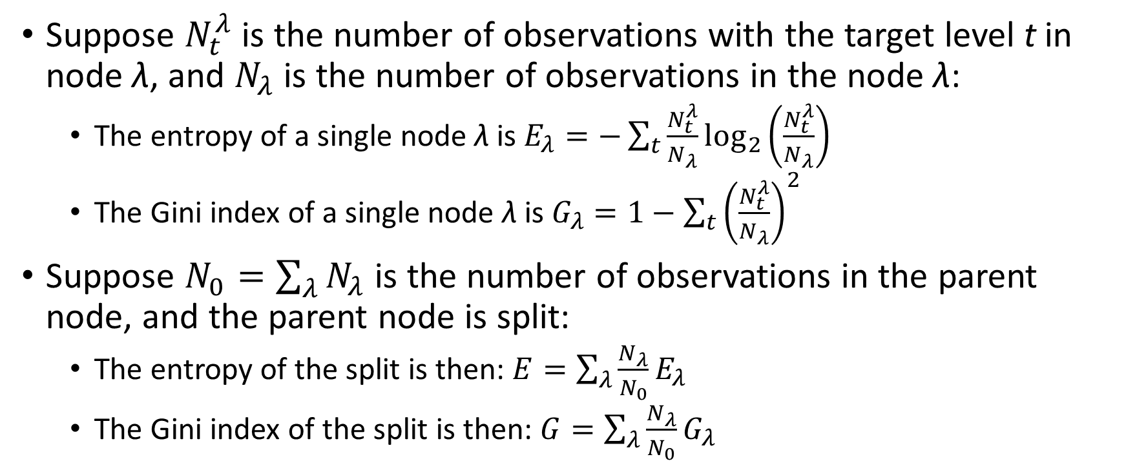
Entropy and Gini Index for a Split
Suppose $N_{t}^{λ}$ is the number of observations with the target level t in node λ, and $N_{λ}$ is the number of observations in the node λ:
The entropy of a single node λ is $E_{λ}=−\sum_{t}{\frac{N_{t}^{λ}}{N_{λ}}}\log_{2}\left(\frac{N_{t}^{λ}}{N_{λ}}\right)$
The Gini index of a single node λ is $G_{λ}=1−\sum_{t}{{\left(\frac{N_{t}^{λ}}{N_{λ}}\right)}^{2}}$
Suppose $N_{0}=\sum_{λ}{N_{λ}}$ is the number of observations in the parent node, and the parent node is split:
The entropy of the split is then: $E=\sum_{λ}{\frac{N_{λ}}{N_{0}}E_{λ}}$
The Gini index of the split is then: $G=\sum_{λ}{\frac{N_{λ}}{N_{0}}G_{λ}}$

Slide 35
CART Algorithm: Entropy vs. Gini Index
Consider the binary target variable
Gini Index tends to be very small when some target categories are rare
Gini Index may be an advantage for rare events
Otherwise, both metrics are equally effective for most of the analyses
Entropy is usually preferred as it has a fixed range of [0,1]

Slide 36
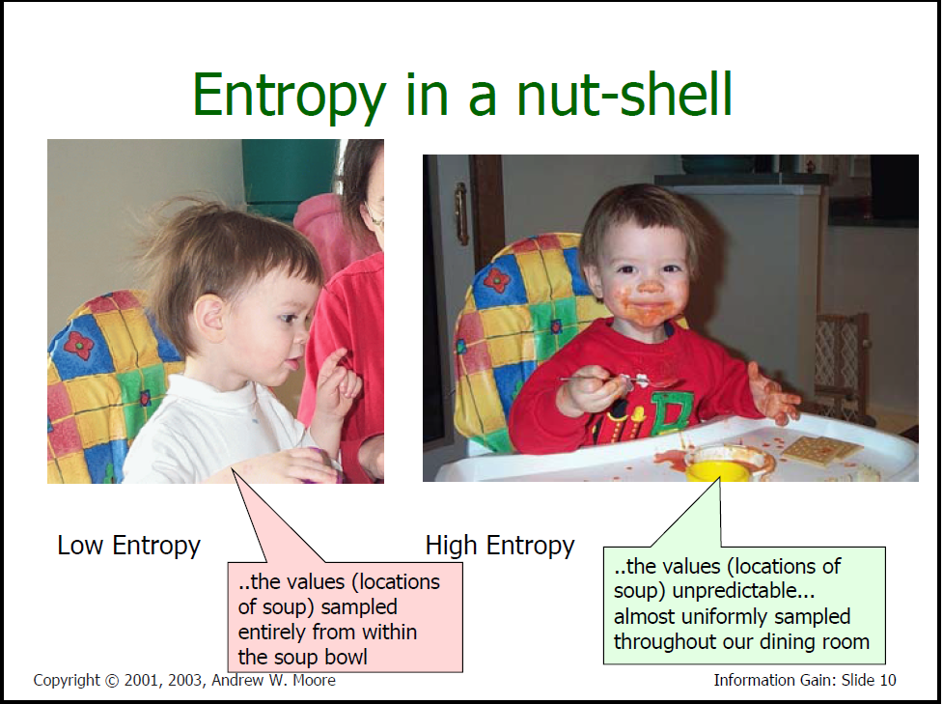
Entropy in a Nut-Shell ☺
Source: https://www.autonlab.org/_media/tutorials/infogain11.pdf, September 19, 2018

Slide 37
ToyTree: Step-by-Step Calculation
ToyTree.csv
Twenty observations
CaseID – observation identifier
A – nominal predictor with three categories: Low, Medium, and High
B – nominal target with two categories: No and Yes
CaseID | A | B |  | CaseID | A | B
1 | Medium | No |  | 11 | Medium | Yes
2 | High | No |  | 12 | Low | Yes
3 | Medium | Yes |  | 13 | Low | No
4 | Medium | Yes |  | 14 | Medium | Yes
5 | High | Yes |  | 15 | High | No
6 | High | No |  | 16 | Medium | Yes
7 | High | No |  | 17 | Medium | Yes
8 | High | No |  | 18 | Medium | Yes
9 | Medium | Yes |  | 19 | Low | Yes
10 | Medium | Yes |  | 20 | High | No
Week 6 StepByStep.py

Slide 38
ToyTree: Step-by-Step Calculation
Build a contingency table
Entropy of the Root Node - ((8/20) * log₂(8/20) + (12/20) * log₂(12/20)) = 0.9709505944547
A | B
 | No | Yes | Total
Low | 1 | 2 | 3
Medium | 1 | 9 | 10
High | 6 | 1 | 7
Total | 8 | 12 | 20

Slide 39
ToyTree: Step-by-Step Calculation
Consider {Low and Medium} and {High}
{Low and Medium}: entropy = - ((2/13) * log₂(2/13) + (11/13) * log₂(11/13)) = 0.6193821946788
{High}: entropy = - ((6/7) * log₂(6/7) + (1/7) * log₂(1/7)) = 0.4010507031511
Split: entropy = (13/20) * 0.6193821946788 + (7/20) * 0.4010507031511 = 0.6096838990450
A | B
 | No | Yes | Total
Low & Medium | 2 | 11 | 13
High | 6 | 1 | 7
Total | 8 | 12 | 20

Slide 40
ToyTree: Step-by-Step Calculation
Consider {Low and High} and {Medium}
{Low and High}: entropy = - ((7/10) * log₂(7/10) + (3/10) * log₂(3/10)) = 0.8812908992307
{Medium}: entropy = - ((1/10) * log₂(1/10) + (9/10) * log₂(9/10)) = 0.4689955935893
Split: entropy = (10/20) * 0.8812908992307 + (10/20) * 0.4689955935893 = 0.6751432464100
A | B
 | No | Yes | Total
Low & High | 7 | 3 | 10
Medium | 1 | 9 | 10
Total | 8 | 12 | 20

Slide 41
ToyTree: Step-by-Step Calculation
Consider {Low} and {Medium and High}
{Low}: entropy = - ((1/3) * log₂(1/3) + (2/3) * log₂(2/3)) = 0.9182958340545
{Medium and High}: entropy = - ((7/17) * log₂(7/17) + (10/17) * log₂(10/17)) = 0.9774178175282
Split: entropy = (3/20) * 0.9182958340545 + (17/20) * 0.9774178175282 = 0.9685495200071
A | B
 | No | Yes | Total
Low | 1 | 2 | 3
Medium and High | 7 | 10 | 17
Total | 8 | 12 | 20

Slide 42
ToyTree: Select a Split
{Root}: Entropy = 0.9709505944547
{Low and Medium}, {High}:
Entropy = 0.6096838990450
Reduction = 0.9709505944547 - 0.6096838990450 = 0.3612666954097
{Low and High}, {Medium}:
Entropy = 0.6751432464100
Reduction = 0.9709505944547 - 0.6751432464100 = 0.2958073480447
{Low}, {Medium and High}:
Entropy = 0.9685495200071
Reduction = 0.9709505944547 - 0.9685495200071 = 0.0024010744476
Since the split {Low and Medium}, {High} gives the largest reduction in entropy (0.3612666954097 to be exact), the child nodes in the first split are {Low and Medium} and {High}.

Slide 43
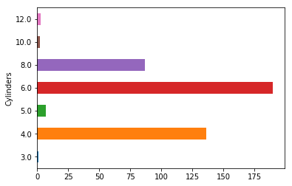
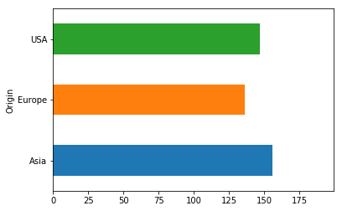
Cars: Step-by-Step Calculation
Data is cars.csv
Ordinal predictor is Cylinders
3, 4, 5, 6, 8, 10, 12
Categorical target is Origin
Asia, Europe, USA
Use observations where both Cylinders and Origin are not missing
426 observations

Slide 44
Cars: Step-by-Step Calculation
Cylinders | Origin
 | Asia | Europe | USA | All
3 | 1 | 0 | 0 | 1
4 | 74 | 25 | 37 | 136
5 | 0 | 7 | 0 | 7
6 | 69 | 54 | 67 | 190
8 | 12 | 34 | 41 | 87
10 | 0 | 0 | 2 | 2
12 | 0 | 3 | 0 | 3
All | 156 | 123 | 147 | 426

Slide 45
Cars: Entropy of the Root Node
Entropy
= - ((156/426) * log₂(156/426) + (123/426) * log₂(123/426) + (147/426) * log₂(147/426))
= 1.57789
Cylinders | Origin
 | Asia | Europe | USA | All
3 | 1 | 0 | 0 | 1
4 | 74 | 25 | 37 | 136
5 | 0 | 7 | 0 | 7
6 | 69 | 54 | 67 | 190
8 | 12 | 34 | 41 | 87
10 | 0 | 0 | 2 | 2
12 | 0 | 3 | 0 | 3
All | 156 | 123 | 147 | 426

Slide 46
Cars: Possible Splits
Split | Entropy
(3), (4, 5, 6, 8, 10, 12) | 1.57448
(3, 4), (5, 6, 8, 10, 12) | 1.52877
(3, 4, 5), (6, 8, 10, 12) | 1.54043
(3, 4, 5, 6), (8, 10, 12) | 1.52407 | Optimal Split since it yields lowest Entropy
(3, 4, 5, 6, 8), (10, 12) | 1.56939
(3, 4, 5, 6, 8, 10), (12) | 1.56518

Slide 47
Cars: Optimal Split on Cylinders
Cylinders | Origin
 | Asia | Europe | USA | All
3, 4 ,5 ,6 | 144 | 86 | 104 | 334
8, 10, 12 | 12 | 37 | 43 | 92
All | 156 | 123 | 147 | 426
The differences between the two distributions are more obvious on the percentage scale
Cylinders | Origin
 | Asia | Europe | USA | All
3, 4 ,5 ,6 | 43% | 26% | 31% | 100%
8, 10, 12 | 13% | 40% | 47% | 100%
All | 37% | 29% | 35% | 100%

Slide 48
Cars: Possible Splits
Cylinders | Split | Entropy
<= 7 | (3), (4, 5, 6) | 1.54781
 | (3, 4), (5, 6) | 1.52178 | Optimal Split, lowest Entropy within Cylinders <= 7
 | (3, 4, 5), (6) | 1.53338
> 7 | (8), (10, 12) | 1.41019
 | (8, 10), (12) | 1.38063 | Optimal Split, lowest Entropy within Cylinders > 7

Slide 49
Cars: Optimal Split on Cylinders
Cylinders | Origin
 | Asia | Europe | USA | All
3, 4 | 75 (55%) | 25 (18%) | 37 (27%) | 137 (100%)
5, 6 | 69 (35%) | 61 (31%) | 67 (34%) | 197 (100%)
8, 10 | 12 (13%) | 34 (38%) | 43 (48%) | 89
12 | 0 (0%) | 3 (100%) | 0 (0%) | 3 (100%)
All | 156 (37%) | 123 (29%) | 147 (35%) | 426

Slide 50
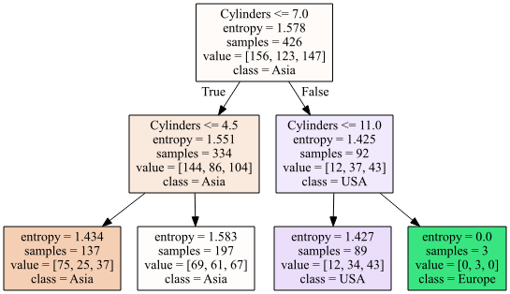
Cars: Optimal Split on Cylinders

Slide 51
CART Algorithm: Stopping Rules
Any of the following conditions will prevent a node from being split:
The node is pure (i.e., values of the target variable are constant in the node)
All predictors are constant in the node
The tree depth for the current node is the maximum tree depth.
The number of observations in any of the child nodes resulting from the node’s best split is less than the minimum child node size (a.k.a. minimum leaf size).
The number of observations in a parent node is less than the minimum parent node size (a.k.a. minimum split size)
The number of terminal nodes reaches the maximum number of leaves.

Slide 52
Decision Tree: Missing Values
Target Variable:
Missing values in target variables are always discarded
Predictors:
Missing values in predictors may be retained and used.
Missing values of a predictor may be treated as a separate unique category decision or merged into other categories (e.g., the mode category which has the most number of observations).

Slide 53
Decision Tree: Missing Values
Predictors:
One advantage of keeping missing values is the same number of observations is used for each predictor.
Another advantage is the occurrence of a particular target variable value may be associated with the presence of missing values in some predictors.
For example, observations with missing Debt to Income Ratios may also have higher default rates

Slide 54
The Pitfall of Over-fitting the Data
Applying splitting criteria usually results in a large tree that provides a good fit to the training data.
The problem with this tree is its potential for overfitting the data: the tree can be overly tailored to the training data and not generalize well to new data.
Over-fitting means the model is more complex than it should be, and therefore the model may pick up noise instead of signal.
Decision trees tend to over-fit data because I can keep on adding nodes such that the nodes contain only one observation.
Think about a scenario when a predictor is essentially the case ID

Slide 55
Pruning Criteria
The solution is to find a smaller subtree that results in a low error rate on holdout or validation data.
It is often computationally prohibitive to evaluate the error on all possible subtrees of the full tree.
A more practical strategy is to focus on a sequence of nested trees obtained by successively pruning leaves from the tree, starting from the terminal nodes. This process is repeated until only the root node remains.
Pruning implies to assess the impact on the goodness-of-fit of the tree if terminal nodes (that come from the same parent node) are combined.

Slide 56
Pruning Criteria
Remove Node 4 and Node 5.
Compare the Full Tree and the Nested Tree by comparing the pruning criterion metric on an independent dataset.
In practice, the independent datasets are created through cross-validation. For example, divide the data into ten equal parts, build the tree using all nine parts, and validate the tree using the remaining tenth part.

Slide 57
Pruning Criteria
Several well-known pruning methods will be described in this slide, however, you can always override the final selected tree based on your preferences or domain knowledge.
Pruning Methods:
Cost-complexity – Breiman, L., Friedman, J., Olshen, R. A., and Stone, C. J. (1984). Classification and Regression Trees. Belmont, CA: Wadsworth.
C4.5 – Quinlan, J. R. (1993). C4.5: Programs for Machine Learning. San Francisco: Morgan Kaufmann. Only for the categorical target.
Reduced Error – Quinlan, J. R. (1987). “Simplifying Decision Trees.” International Journal of Man-Machine Studies 27:221–234.
Reference: http://support.sas.com/documentation/cdl/en/stathpug/68163/HTML/default/viewer.htm#stathpug_hpsplit_details06.htm

Slide 58
Which Pruning Method to use?
My experience suggests trying all three methods (exclude C4.5 if your target variable is an interval variable).
It is because the model assessment statistics (under the three methods) are usually similar.
Pick the tree that meets your needs!
Big versus small trees?
Lowest misclassification rate?
Highest entropy (or Gini index)?
Make the most sense based on your domain knowledge?

Slide 59
Python Modules
sklearn.tree: Decision Trees
tree.DecisionTreeClassifier() A decision tree classifier.
tree.DecisionTreeRegressor() A decision tree regressor.
tree.export_graphviz() Export a decision tree in DOT.
graphviz: Rendering DOT
graphviz.Source() Convert DOT into a graph.
render() Render the graph into PDF.

Slide 60
The Caveat of sklearn.tree: Decision Trees
Assume all input fields are interval variables
Does not handle string input variables
Require all observations are complete, i.e., no missing values
Does not handle missing values in input fields
Does not support pruning
Does not carry the variables’ names in the output

Slide 61
Use Decision Tree to Describe Clusters
Apply a clustering algorithm to divide the observations into non-overlapping clusters.
Use the arbitrary cluster IDs as the target variable in a decision tree, the input fields for the decision tree are those for the clustering.
The goal is NOT to re-discover the clusters.
The goal is to describe the majority of observations in a cluster by a decision tree rule.

Slide 62
Capital Bike Share Data
Kaggle provides us a data on the bicycle rental demand in the Capital Bikeshare program in Washington, DC. The data combines historical usage patterns with weather data. You can learn more about this data at https://www.kaggle.com/c/bike-sharing-demand.
Data is BikeSharingDemand_Train.csv, use three interval predictors:
temp – hourly temperature in Celsius
humidity – humidity in percent
windspeed – windspeed in km/h
Use observations where all four predictors are not missing
10,886 observations
Code: Week 6 BikeShare ClusterTree.py

Slide 63
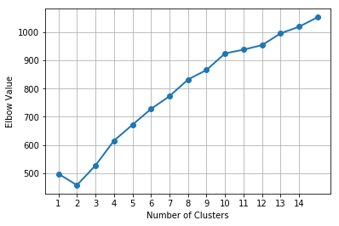
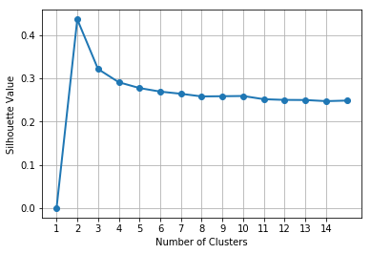
Bike Share - Clustering
Try the number of clusters from 1 to 15
Use the Elbow and the Silhouette metrics to determine the number of clusters
Determine 2 as the number of clusters
Centroids are:
Cluster | Size | temp | humidity | windspeed
0 | 5,466 | 20.076 | 78.0 | 10.25922
1 | 5,420 | 20.387 | 45.6 | 15.36113

Slide 64
Bike Share – Cluster Description
The two clusters apparently divided the data almost equally.
The mean temperatures of the two clusters are almost the same.
Cluster 0 has higher mean humidity and lower mean windspeed.
Cluster 1 has lower mean humidity and higher mean windspeed.
Cluster | Size | temp | humidity | windspeed
0 | 5,466 | 20.076 | 78.0 | 10.25922
1 | 5,420 | 20.387 | 45.6 | 15.36113

Slide 65
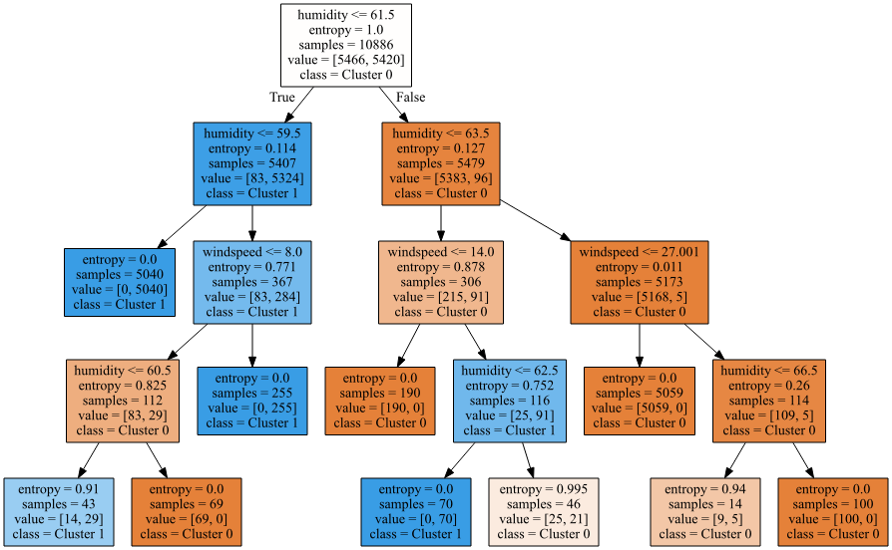
Bike Share – Decision Tree
Cluster ID is the target
temp, humidity, and windspeed are predictors
Maximum depth is 4
Splitting criterion is Entropy
Accuracy is 0.9963
99.63% of observations are correctly classified

Slide 66
Bike Share – Node Description
Rule | Entropy | Cluster 0 | Cluster 1 | Classification
humidity <= 61.5 & humidity <= 59.5 | 0 | 0 | 5040 | Cluster 1
humidity <= 61.5 & humidity > 59.5 & windspeed <= 8 & humidity <= 60.5 | 0.91 | 14 | 29 | Cluster 1
humidity <= 61.5 & humidity > 59.5 & windspeed <= 8 & humidity > 60.5 | 0 | 69 | 0 | Cluster 0
humidity <= 61.5 & humidity > 59.5 & windspeed > 8 | 0 | 0 | 255 | Cluster 1
humidity > 61.5 & humidity <= 63.5 & windspeed <= 14 | 0 | 190 | 0 | Cluster 0
humidity > 61.5 & humidity <= 63.5 & windspeed > 14 & humidity <= 62.5 | 0 | 0 | 70 | Cluster 1
humidity > 61.5 & humidity <= 63.5 & windspeed > 14 & humidity > 62.5 | 0.995 | 25 | 21 | Cluster 0
humidity > 61.5 & humidity > 63.5 & windspeed <= 27.001 | 0 | 5095 | 0 | Cluster 0
humidity > 61.5 & humidity > 63.5 & windspeed > 27.001 & humidity <= 66.5 | 0.94 | 9 | 5 | Cluster 0
humidity > 61.5 & humidity > 63.5 & windspeed > 27.001 & humidity > 66.5 | 0 | 100 | 0 | Cluster 0

Slide 67
Bike Share – Node Description
Rule | Entropy | Cluster 0 | Cluster 1 | Classification
humidity > 61.5 & humidity > 63.5 & windspeed <= 27.001 | 0 | 5095 | 0 | Cluster 0
humidity > 61.5 & humidity <= 63.5 & windspeed <= 14 | 0 | 190 | 0 | Cluster 0
humidity > 61.5 & humidity > 63.5 & windspeed > 27.001 & humidity > 66.5 | 0 | 100 | 0 | Cluster 0
humidity <= 61.5 & humidity > 59.5 & windspeed <= 8 & humidity > 60.5 | 0 | 69 | 0 | Cluster 0
humidity <= 61.5 & humidity <= 59.5 | 0 | 0 | 5040 | Cluster 1
humidity <= 61.5 & humidity > 59.5 & windspeed > 8 | 0 | 0 | 255 | Cluster 1
humidity > 61.5 & humidity <= 63.5 & windspeed > 14 & humidity <= 62.5 | 0 | 0 | 70 | Cluster 1
humidity <= 61.5 & humidity > 59.5 & windspeed <= 8 & humidity <= 60.5 | 0.91 | 14 | 29 | Cluster 1
humidity > 61.5 & humidity > 63.5 & windspeed > 27.001 & humidity <= 66.5 | 0.94 | 9 | 5 | Cluster 0
humidity > 61.5 & humidity <= 63.5 & windspeed > 14 & humidity > 62.5 | 0.995 | 25 | 21 | Cluster 0

Slide 68
Bike Share – Node Description
Rule | Classification | N Obs. | % Within Cluster
humidity > 63.5 & windspeed <= 27.001 | Cluster 0 | 5095 | 93%
61.5 < humidity <= 63.5 & windspeed <= 14 | Cluster 0 | 190 | 3%
humidity > 66.5 & windspeed > 27.001 | Cluster 0 | 100 | 2%
humidity <= 61.5 & windspeed <= 8 | Cluster 0 | 69 | 1%
humidity <= 59.5 | Cluster 1 | 5040 | 93%
59.5 < humidity <= 61.5 & windspeed > 8 | Cluster 1 | 255 | 5%
61.5 < humidity <= 62.5 & windspeed > 14 | Cluster 1 | 70 | 1%

Slide 69
Bike Share – Node Description
We found two clusters, identified as 0 and 1.
Cluster 0 has 5,466 observations.
Among 93% of these observations, we observed that humidity > 63.5 and windspeed <= 27.001.
We, therefore, can conclude that Cluster 0 is characterized by a relatively more humid (or basically comfortable) day with light to calm breeze.
Cluster 1 has 5,420 observations.
Among 93% of these observations, we observed that humidity <= 59.5.
We, therefore, can conclude that Cluster 01 is characterized by a relatively less humid (or practically dry) day.

Slide 70
Wrap Up
We covered an overview of the decision tree modeling.
We went through the steps of the CART algorithm.
We learned to use the sklearn.tree to build a decision tree model.
We applied the CART algorithm to describe the clustering results.

